Slide 1
Page Fault

Slide 2
Demand Paging
A demand paging system is quite similar to a paging system with swapping where processes reside in secondary memory and pages are loaded only on demand, not in advance.
When a context switch occurs, the operating system does not copy any of the old program’s pages out to the disk or any of the new program’s pages into the main memory Instead, it just begins executing the new program after loading the first page and fetches that program’s pages as they are referenced.

Slide 3
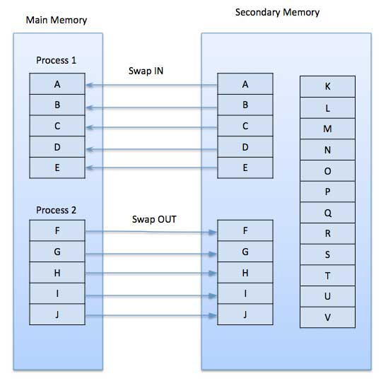

Slide 4
While executing a program, if the program references a page which is not available in the main memory because it was swapped out a little ago, the processor treats this invalid memory reference as a page fault and transfers control from the program to the operating system to demand the page back into the memory.
Advantages
Following are the advantages of Demand Paging −
Large virtual memory.
More efficient use of memory.
There is no limit on degree of multiprogramming.
Disadvantages
Number of tables and the amount of processor overhead for handling page interrupts are greater than in the case of the simple paged management techniques.

Slide 5
Page Replacement Algorithm
Page replacement algorithms are the techniques using which an Operating System decides which memory pages to swap out, write to disk when a page of memory needs to be allocated.
Paging happens whenever a page fault occurs and a free page cannot be used for allocation purpose accounting to reason that pages are not available or the number of free pages is lower than required pages.

Slide 6
When the page that was selected for replacement and was paged out, is referenced again, it has to read in from disk, and this requires for I/O completion.
This process determines the quality of the page replacement algorithm: the lesser the time waiting for page-ins, the better is the algorithm.

Slide 7
A page replacement algorithm looks at the limited information about accessing the pages provided by hardware, and tries to select which pages should be replaced to minimize the total number of page misses, while balancing it with the costs of primary storage and processor time of the algorithm itself.
There are many different page replacement algorithms.
We evaluate an algorithm by running it on a particular string of memory reference and computing the number of page faults.

Slide 8
Reference String
The string of memory references is called reference string.
Reference strings are generated artificially or by tracing a given system and recording the address of each memory reference.
The latter choice produces a large number of data, where we note two things.
For a given page size, we need to consider only the page number, not the entire address.
If we have a reference to a page p, then any immediately following references to page p will never cause a page fault. Page p will be in memory after the first reference; the immediately following references will not fault.
For example, consider the following sequence of addresses − 123,215,600,1234,76,96
If page size is 100, then the reference string is 1,2,6,12,0,0

Slide 9
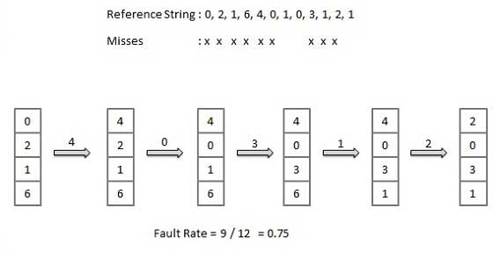
First In First Out (FIFO) algorithm
Oldest page in main memory is the one which will be selected for replacement.
Easy to implement, keep a list, replace pages from the tail and add new pages at the head.

Slide 10
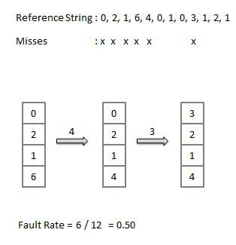
Optimal Page algorithm
An optimal page-replacement algorithm has the lowest page-fault rate of all algorithms. An optimal page-replacement algorithm exists, and has been called OPT or MIN.
Replace the page that will not be used for the longest period of time. Use the time when a page is to be used.(see the future)

Slide 11
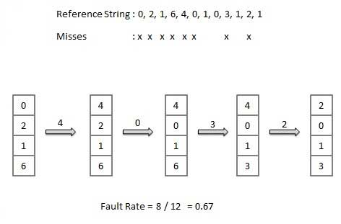
Least Recently Used (LRU) algorithm
Page which has not been used for the longest time in main memory is the one which will be selected for replacement.
Easy to implement, keep a list, replace pages by looking back into time(look in the past)

